Slide 1

Blood Donor Management System
Mukul Rai

Slide 2

Introduction
A blood donor management system is a software application that helps to manage the blood donation process.
Connect donors and blood banks efficiently, and improve blood donation management.
Registering new donors
Tracking blood availability
Announcement-making facility

Slide 3
Overview
Purpose: Facilitate blood donation, and connect donors and blood banks.
Features: Donor registration, blood details management, admin control for announcements.

Slide 4

User Roles
Donors: Contribute, view blood details.
Administrators: Full control over blood collection, donor data, and announcements.

Slide 5
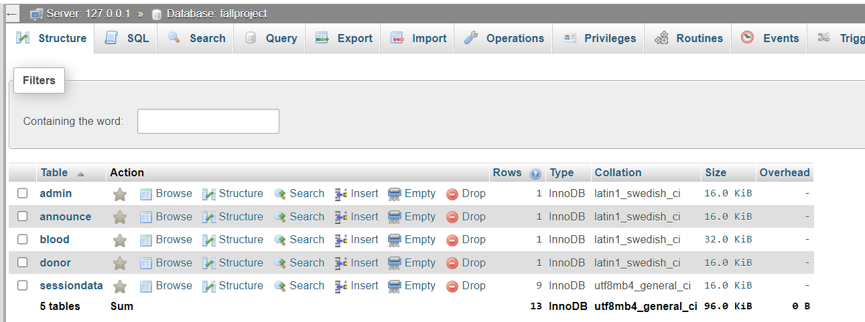
Database Structure
Tables: admin, announce, blood, donor, sessiondata
Key Fields: userId, name, announcement, bloodgroup, dob, weight, etc.
Relationships: Connects user data, blood details, announcements, and session tracking.

Slide 6
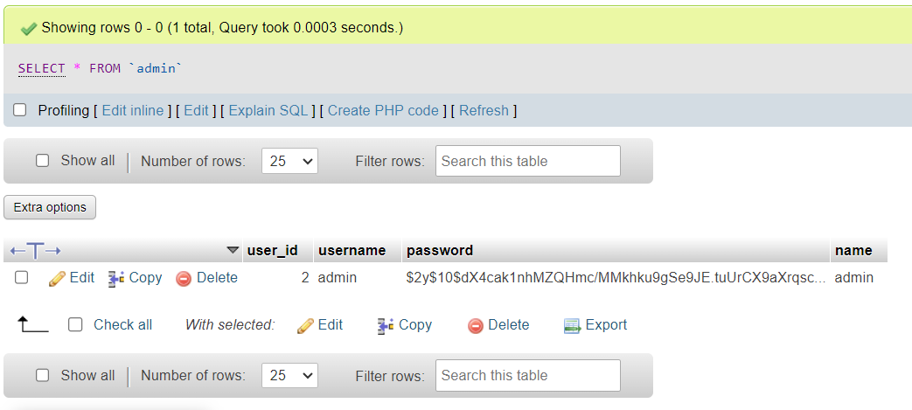
Admin Table
Fields: user_id, username, password, name
Sample Data: (2, 'admin', 'hashed_password', 'admin')

Slide 7
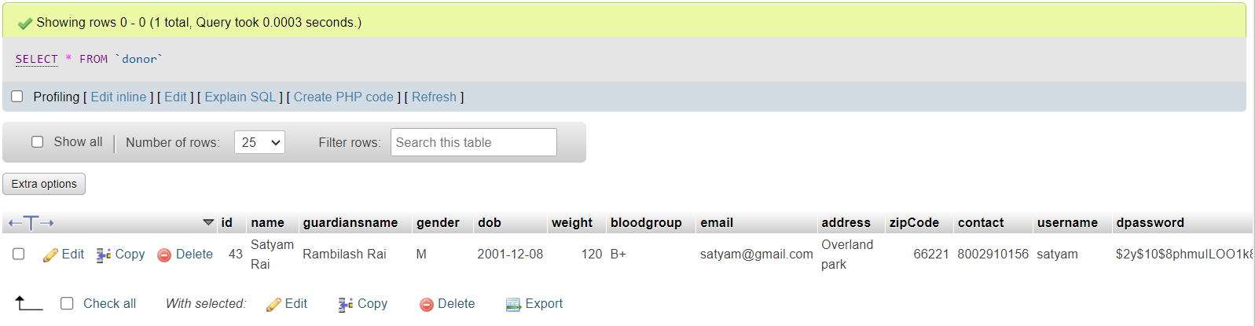
Donor Table
Fields: id, name, guardiansname, gender, dob, weight, bloodgroup, email, address, zipCode, contact, username, dpassword
Sample Data: (43, 'Satyam Rai', 'Rambilash Rai', 'M', '2001-12-08', 120, 'B+', 'satyam@gmail.com', 'Overland park', 66221, '8002910156', 'satyam', 'hashed_password')

Slide 8
Challenges and future scope
Challenges: Data Security, Integration with Healthcare System.
Future Scope: Mobile application development, blockchain for data security, Addition of Reporting and Analysis features.

Slide 9
References
[1] G. Manika, V. S. Reddy, K. S. Vamshi, and Ms. Prashanthi, “Development and implementation of a web-based blood bank management system for efficient blood donation and distribution,” International Journal for Research in Applied Science and Engineering Technology, vol. 11, no. 4, pp. 1830–1834, 2023. doi:10.22214/ijraset.2023.50493
[2] Free web development snippets, tips, and tricks (no date) MarkupTag. Available at: https://www.markuptag.com/ (Accessed: 27 November 2023).
[3] FreeFrontend. Available at: https://freefrontend.com/ (Accessed: 27 November 2023).

